Slide 1


Slide 2

introduction
This project is designed to control speed of a DC motor using an Arduino development board. Speed of the DC motor is directly proportional to the voltage applied across its terminals. Hence, if the voltage across the motor terminal is varied, then the speed can also be varied.

Slide 3
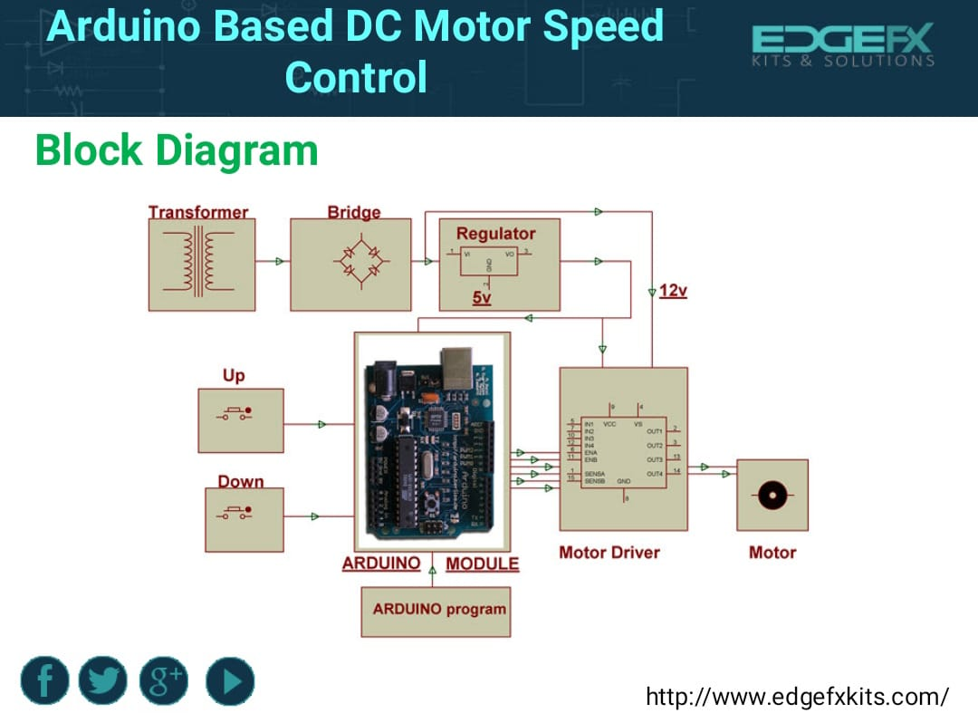

Slide 4

Hardware requirements
Arduino develop Board
Crystal
DC Motor
Motor Driver IC
LED
Resistors
Capacitors
Diodes
Transformer
Voltage Regulator
Push Buttons.

Slide 5
Software requirements
Arduino software
Language: Arduino Programming language

Slide 6
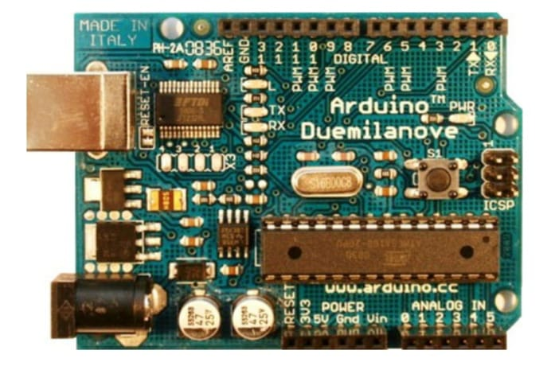
arduino
The Arduino microcontroller is an easy to use yet powerful single board computer that has gained considerable traction
in the hobby and professional market.
The Arduino is open-source, which means
hardware is reasonably priced and
development software is free.

Slide 7
Working of arduino
Inexpensive :
Arduino boards are relatively inexpensive compared to other microcontroller platforms.
Cross-platform :
The Arduino software runs on Windows, Macintosh OSX, and Linux operating systems. Most microcontroller systems are limited to Windows.

Slide 8
Working of arduino
Programming environment :
The Arduino programming environment is easy-to-use for beginners, yet flexible enough for advanced users to take advantage of as well.
Open source and extensible software :
The Arduino software and is published as open source tools, available for extension by experienced programmers.

Slide 9

pwm
The PWM switching frequency has to be much faster than what would affect the load, which is to say the device that uses the power.
The term duty cycle describes the proportion of on time to the regular interval or period of time.
A low duty cycle corresponds to low power, because the power is off for most of the time. Duty cycle is expressed in percent, 100% being fully on.

Slide 10
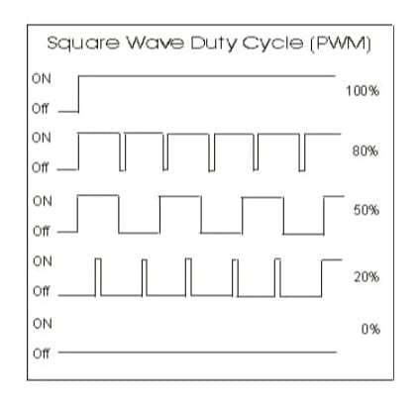
Pwm Applications
Telecommunications
Power delivery
Voltage regulation
Audio effects
Amplification

Slide 11

led
LEDs are semiconductor devices are made out of silicon.
When current passes through the LED, it emits photons as a byproduct'
Normal light bulbs produce light by heating a metal filament until its white hot.

Slide 12
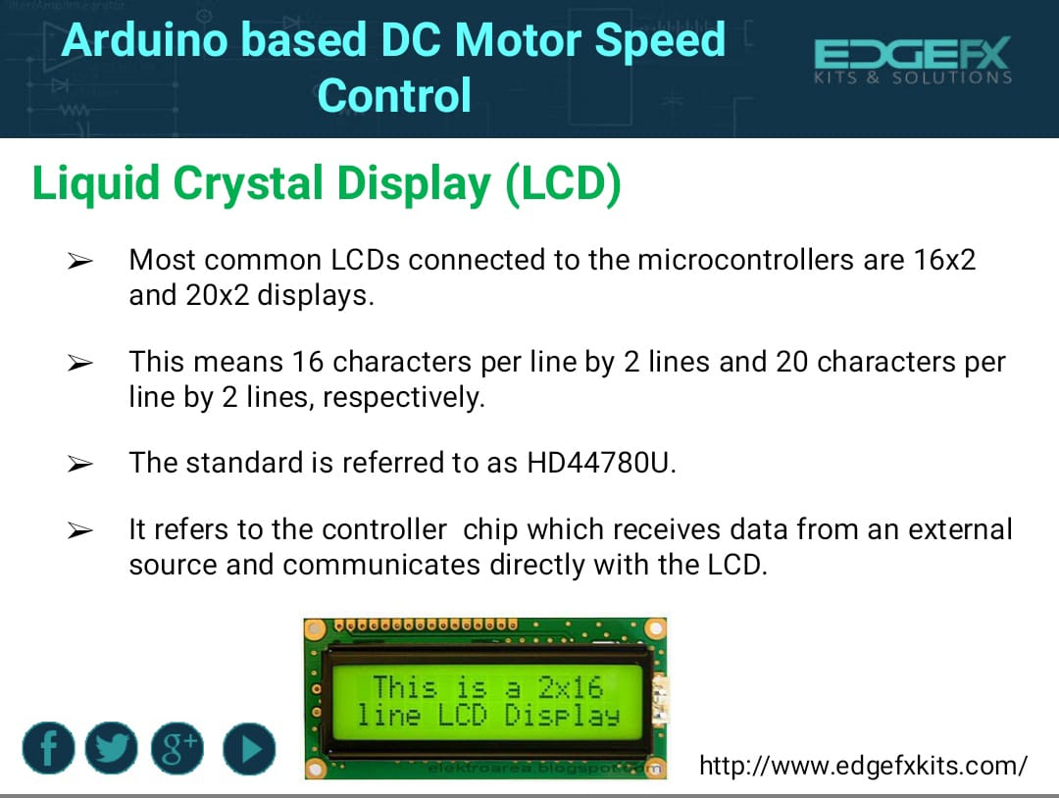

Slide 13
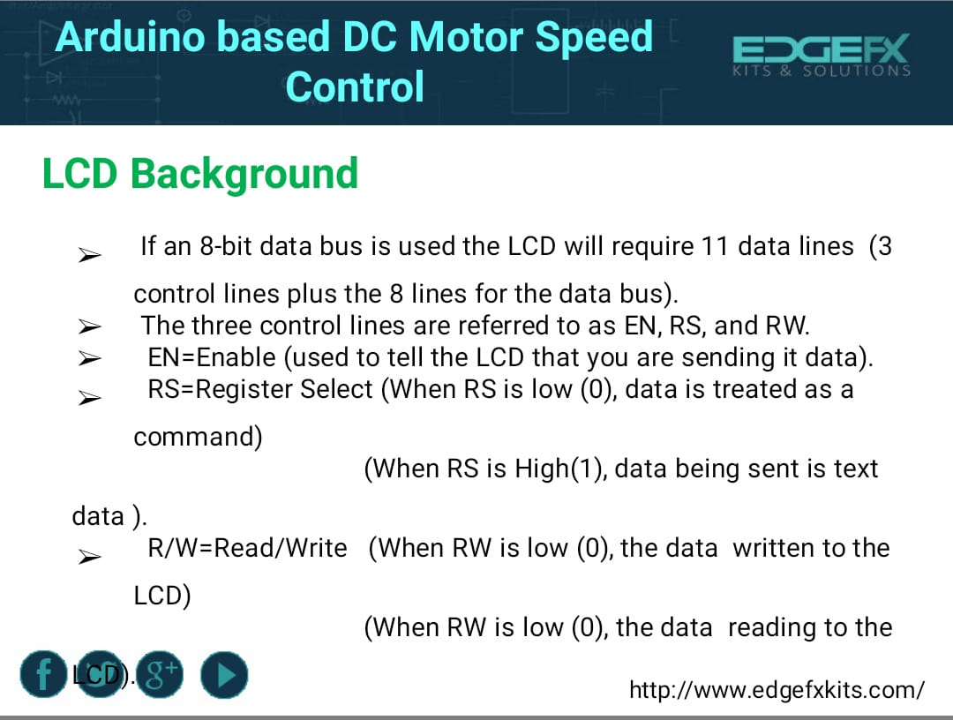

Slide 14
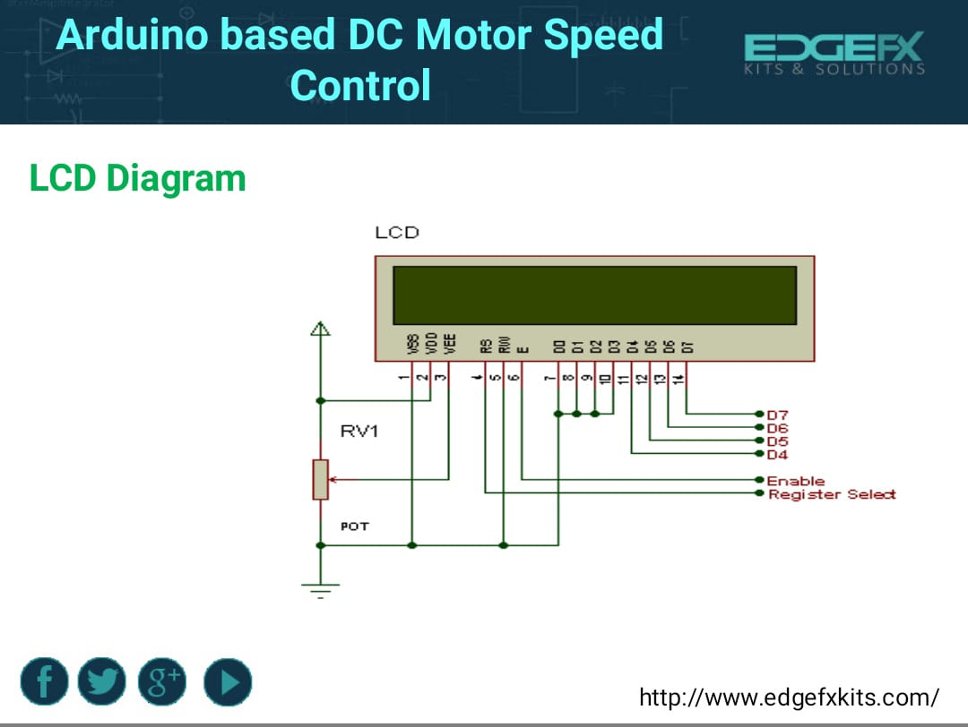

Slide 15


Slide 16
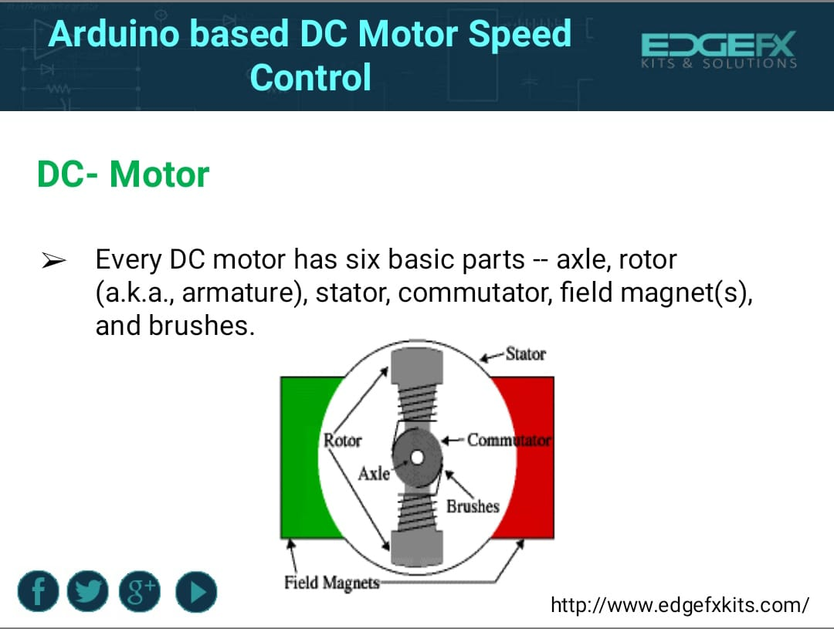

Slide 17
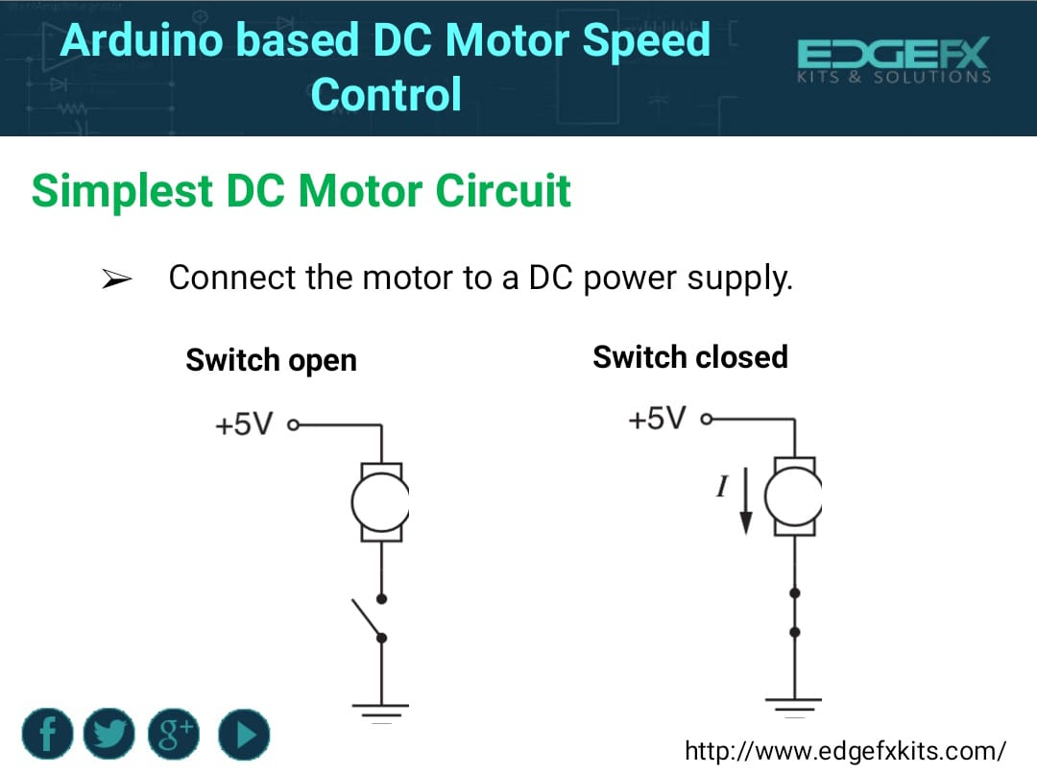

Slide 18


Slide 19


Slide 20


Slide 21
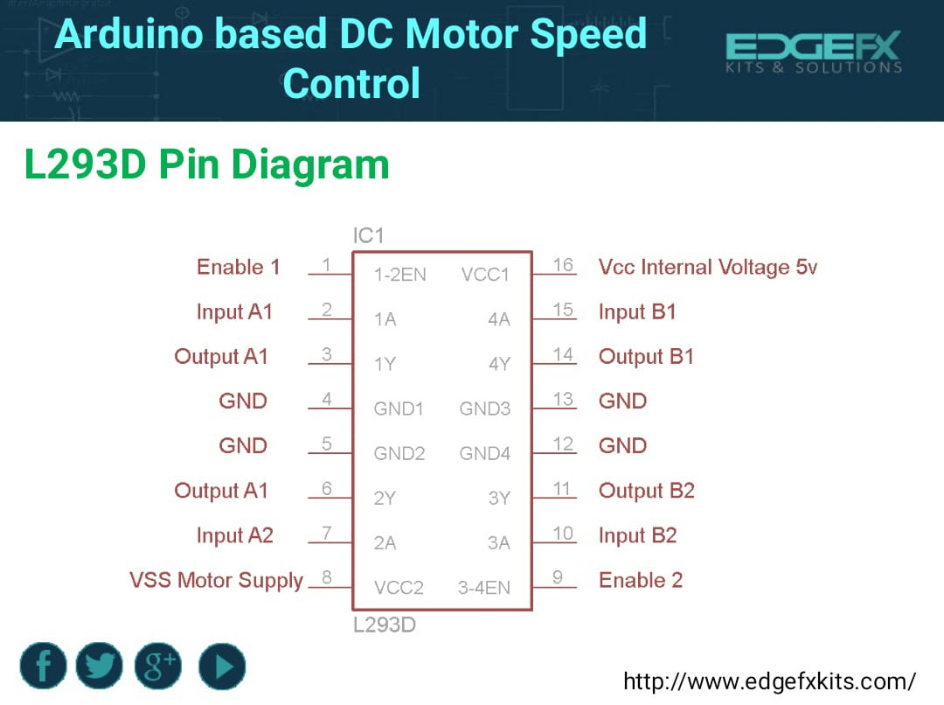

Slide 22
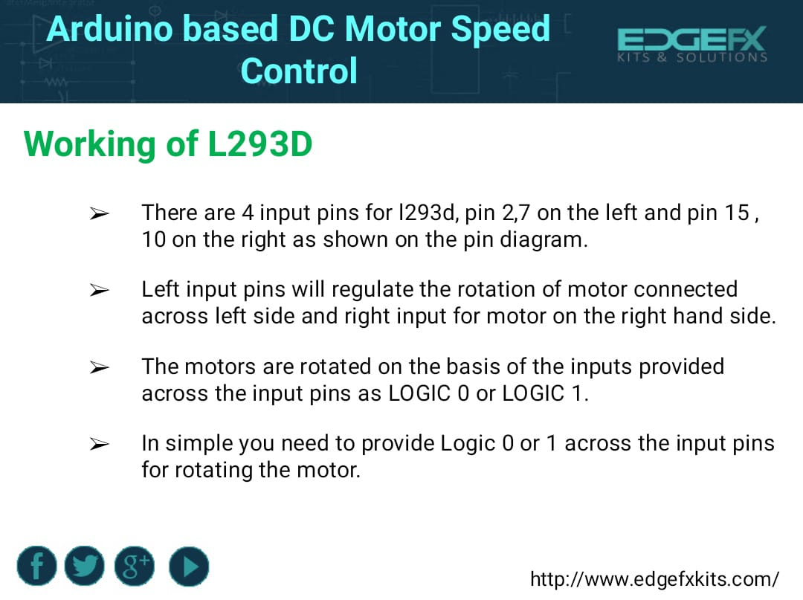

Slide 23


Slide 24


Slide 25


Slide 26
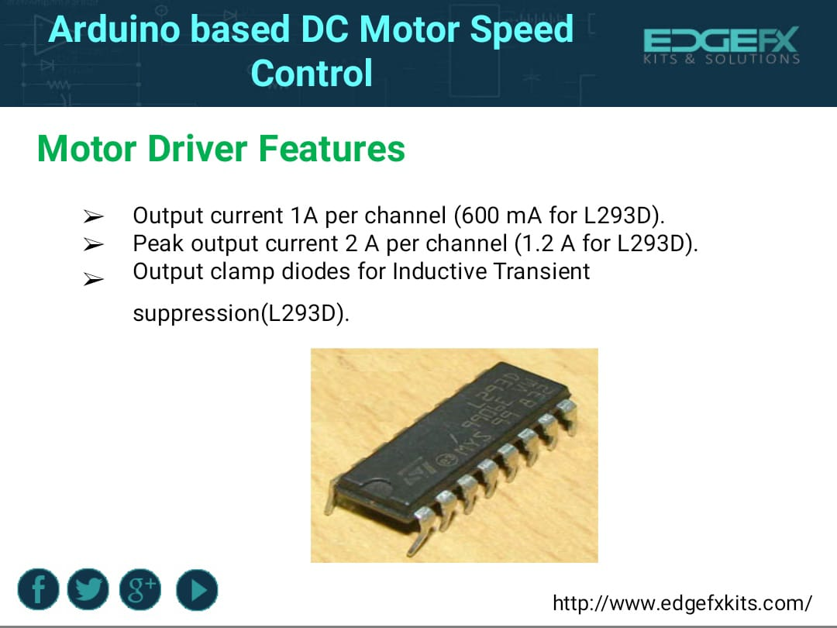

Slide 27
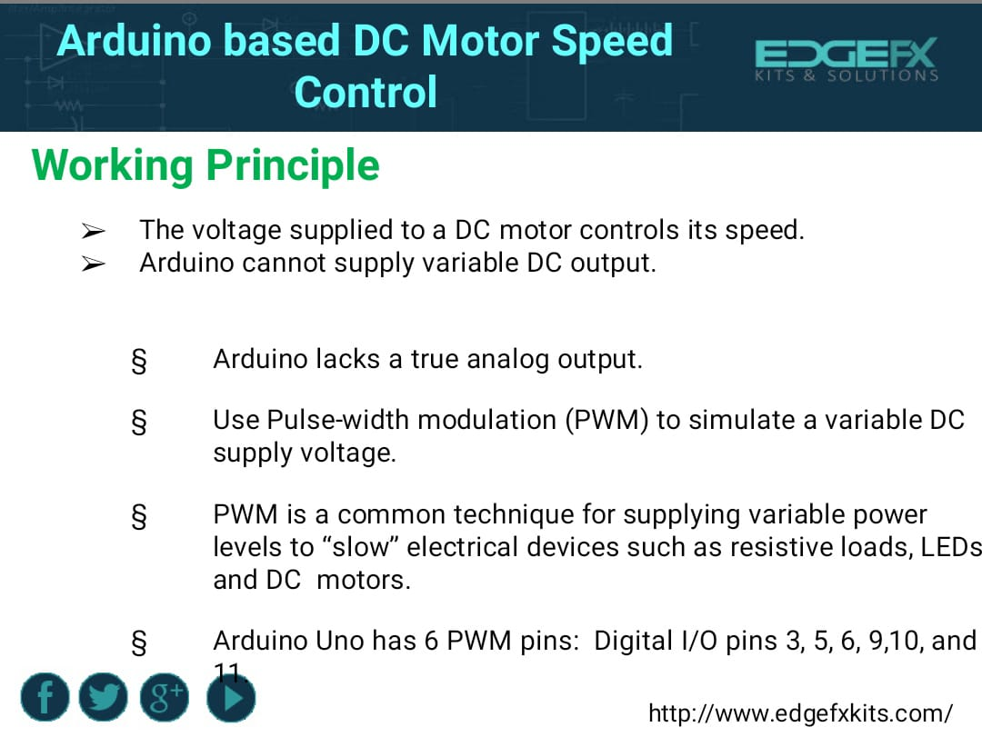

Slide 28


Slide 29


Slide 30


Slide 31


